Slide 1
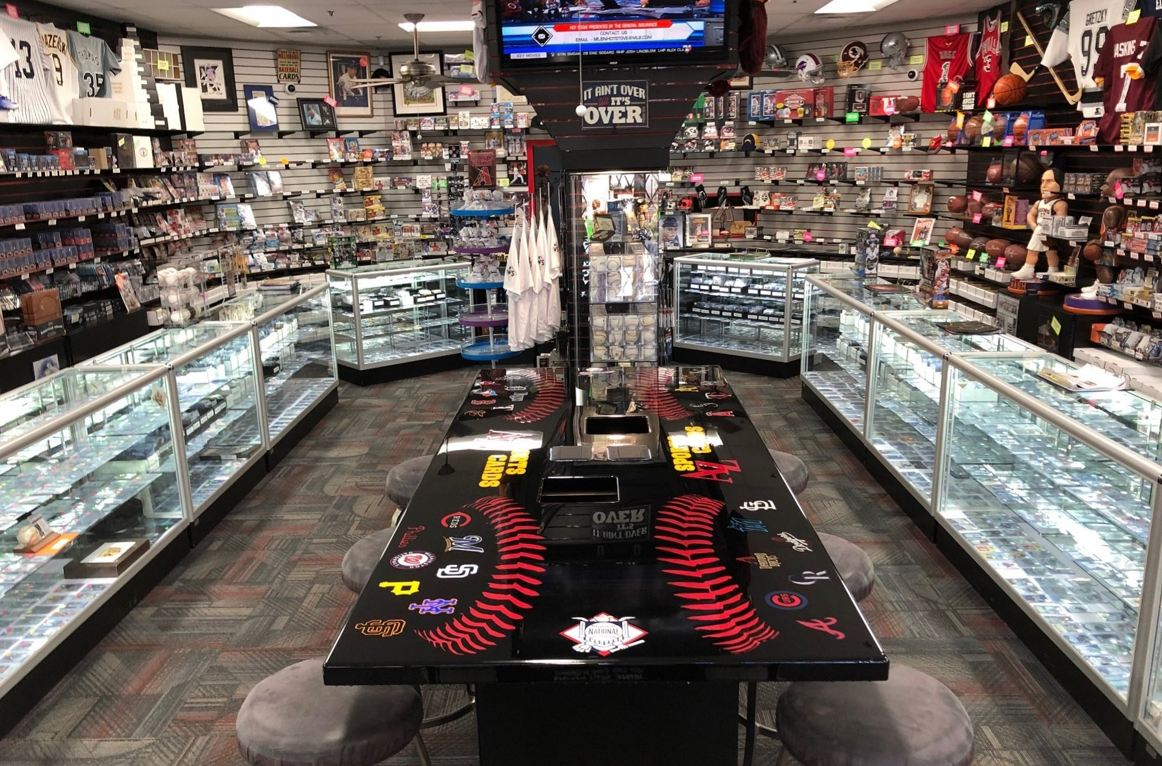
Card Shop
By Matthew D’Sena

Slide 2
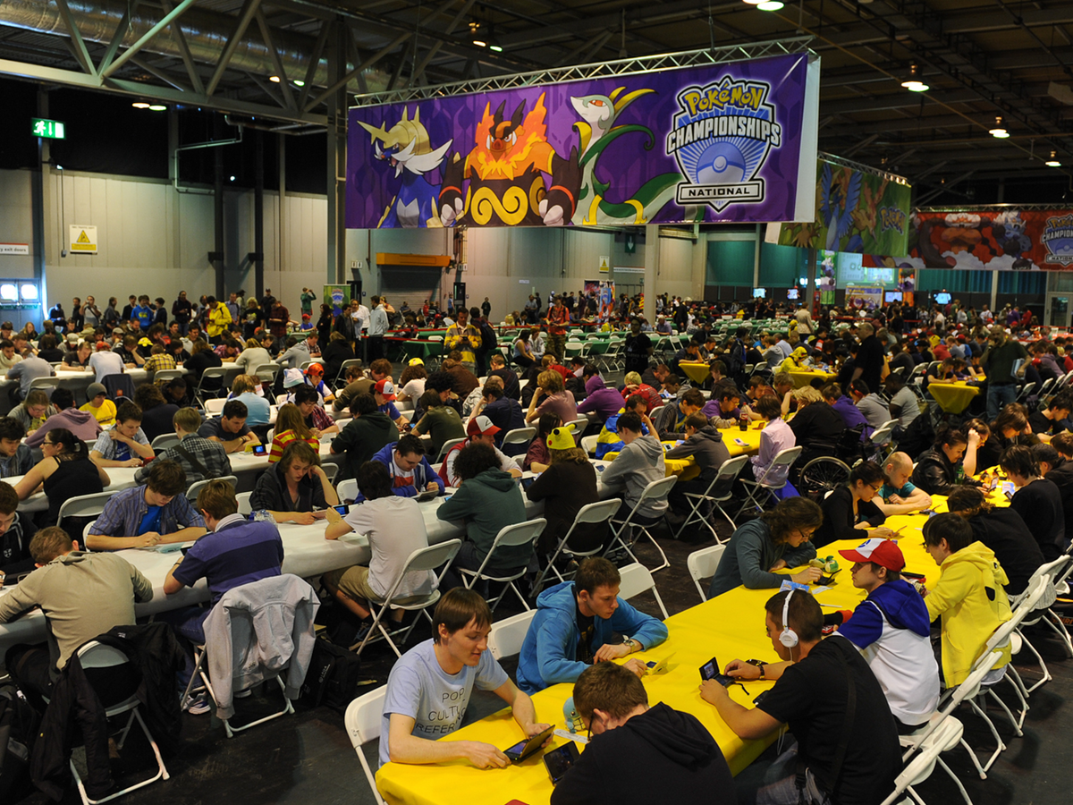

Slide 3
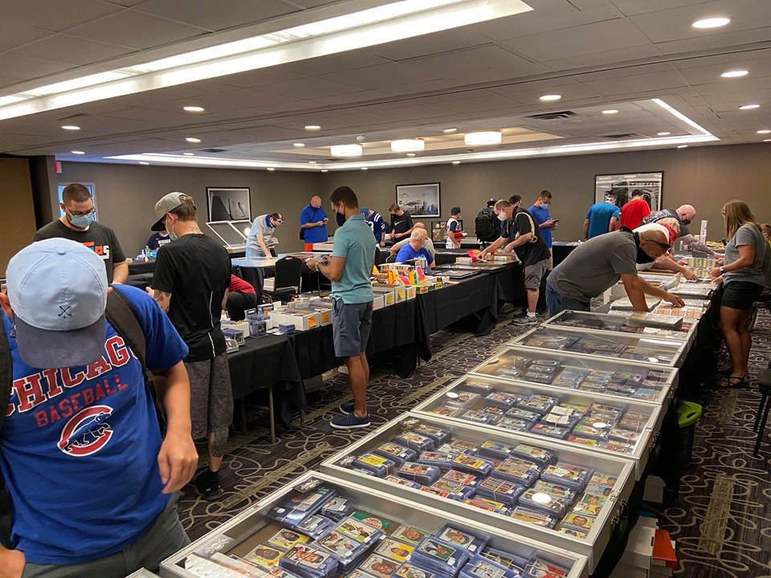

Slide 4

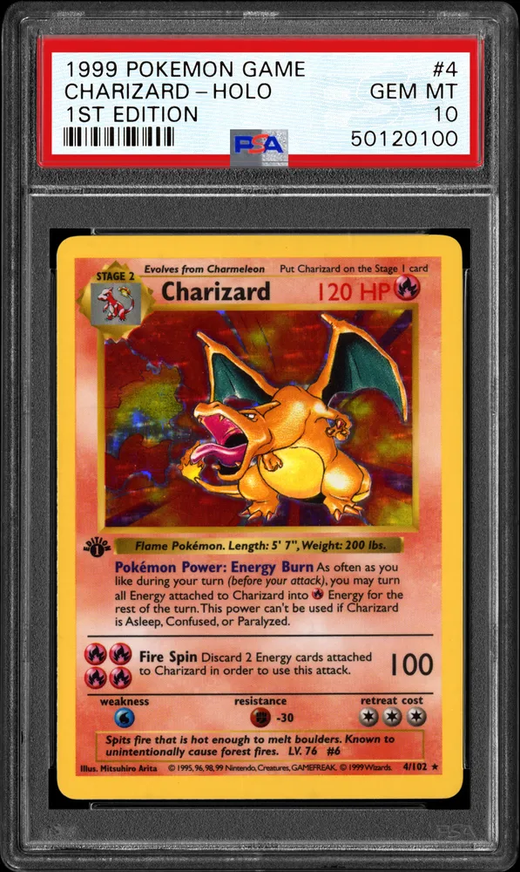
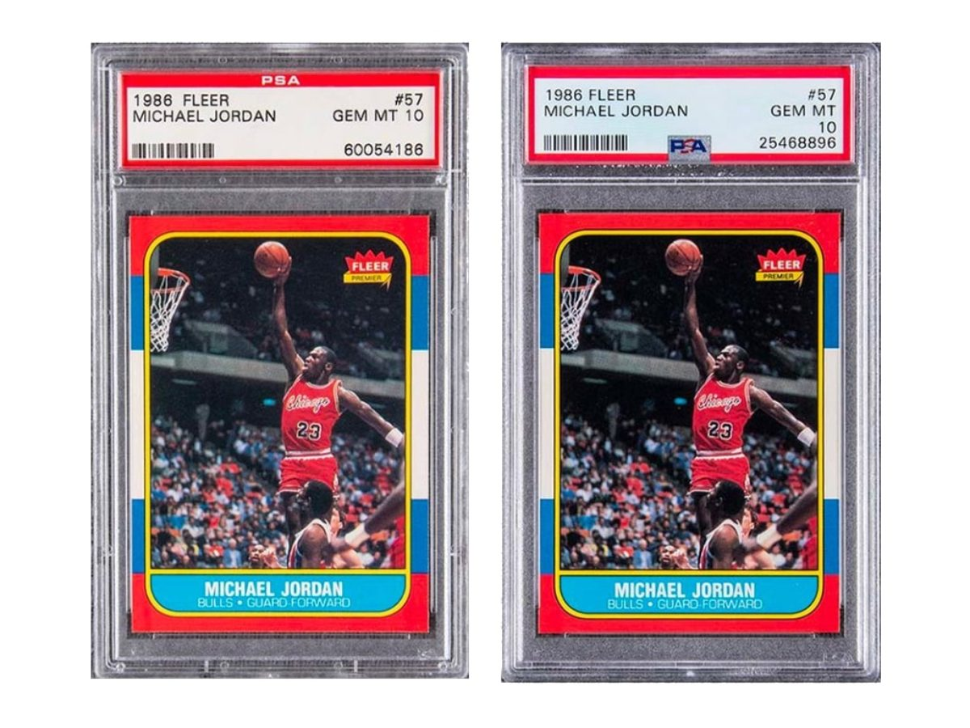
User Story
AS a USER
I WANT a website where I can view & purchase TCG products
SO THAT I can add to my growing collection

Slide 5







Tech Used

Slide 6
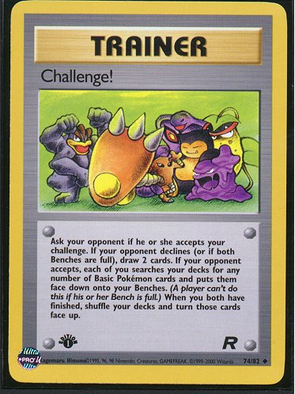

Slide 7
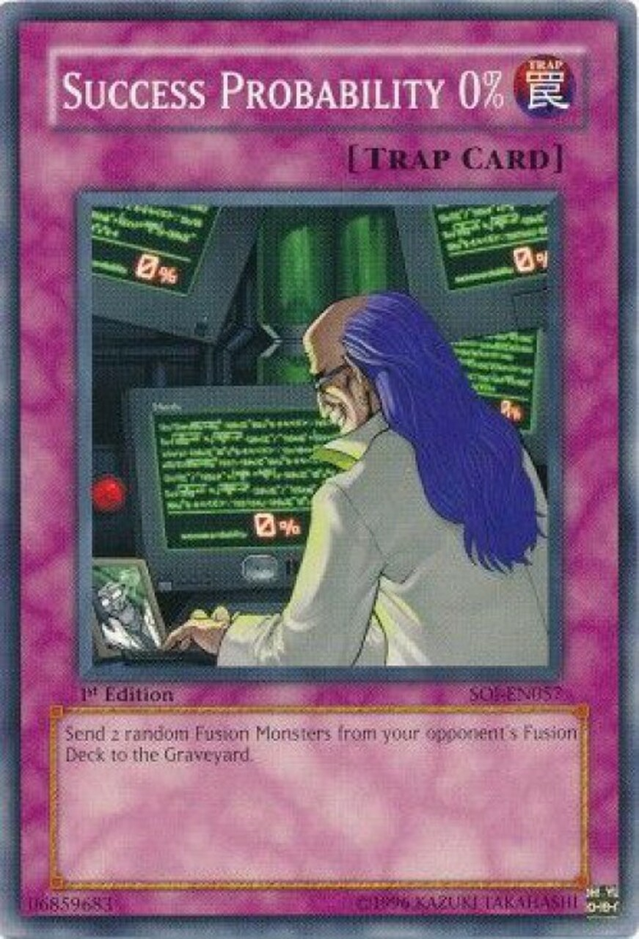

Slide 8


Slide 9
Links
https://mern-cardstore.herokuapp.com/
https://github.com/Mattdsena/Card-Store

